Slide 1
Variant of Binary Tree: AVL (Adelson – Velskii – Landis)-Trees

Slide 2
Balanced binary tree
The disadvantage of a binary search tree is that its height can be as large as N-1
This means that the time needed to perform insertion and deletion and many other operations can be O(N) in the worst case
We want a tree with small height
A binary tree with N node has height at least Θ(log N)
Thus, our goal is to keep the height of a binary search tree O(log N)
Such trees are called balanced binary search trees. Examples are AVL tree, red-black tree.

Slide 3
AVL tree
Height of a node
The height of a leaf is 1. The height of a null pointer is zero.
The height of an internal node is the maximum height of its children plus 1
Note that this definition of height is different from the one we defined previously (we defined the height of a leaf as zero previously).

Slide 4
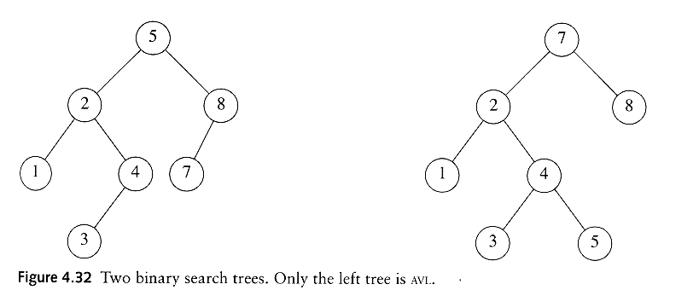
AVL tree
An AVL tree is a binary search tree in which
  for every node in the tree, the height of the left and right subtrees differ by at most 1.
AVL property violated here

Slide 5

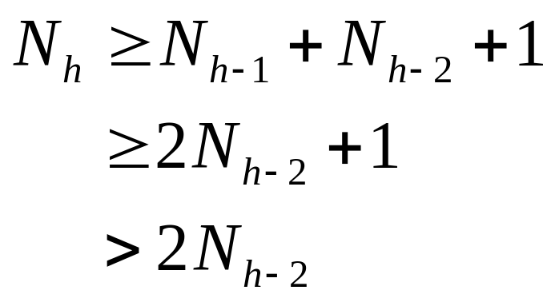
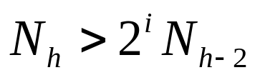
AVL tree
Let x be the root of an AVL tree of height h
Let N_{h} denote the minimum number of nodes in an AVL tree of height h
Clearly, N_{i} ≥ N_{i-1} by definition
We have
By repeated substitution, we obtain the general form
The boundary conditions are: N₁=1 and N₂ =2. This implies that h = O(log N_{h}).
Thus, many operations (searching, insertion, deletion) on an AVL tree will take O(log N) time.

Slide 6
Rotations
When the tree structure changes (e.g., insertion or deletion), we need to transform the tree to restore the AVL tree property.
This is done using single rotation or double rotations.
e.g. Single Rotation
y
x
x
y
C
A
C
B
B
A
Before Rotation
After Rotation

Slide 7
Continued…
Since an insertion/deletion involves adding/deleting a single node, this can only increase/decrease the height of some subtree by 1
Thus, if the AVL tree property is violated at a node x, it means that the heights of left(x) ad right(x) differ by exactly 2.
Rotations will be applied to x to restore the AVL tree property.

Slide 8
Insertion
First, insert the new key as a new leaf just as in ordinary binary search tree
Then trace the path from the new leaf towards the root. For each node x encountered, check if heights of left(x) and right(x) differ by at most 1.
If yes, proceed to parent(x). If not, restructure by doing either a single rotation or a double rotation.
For insertion, once we perform a rotation at a node x, we won’t need to perform any rotation at any ancestor of x.

Slide 9
Insertion
Let x be the node at which left(x) and right(x) differ by more than 1
Assume that the height of x is h+3
There are 4 cases
  Height of left(x) is h+2 (i.e. height of right(x) is h)
    Height of left(left(x)) is h+1 ⇒ single rotate with left child
    Height of right(left(x)) is h+1 ⇒ double rotate with left child
  Height of right(x) is h+2 (i.e. height of left(x) is h)
    Height of right(right(x)) is h+1 ⇒ single rotate with right child
    Height of left(right(x)) is h+1 ⇒ double rotate with right child
Note: Our test conditions for the 4 cases are different from the code shown in the textbook. These conditions allow a uniform treatment between insertion and deletion.

Slide 10
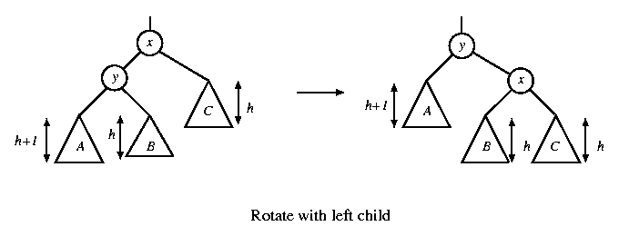
Single rotation
The new key is inserted in the subtree A.
The AVL-property is violated at x
height of left(x) is h+2
height of right(x) is h.

Slide 11
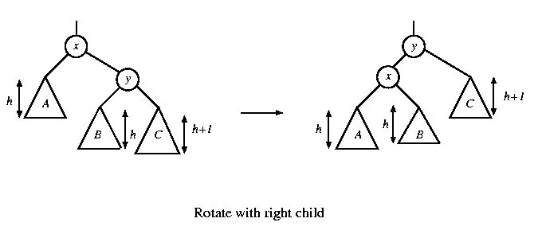
Continued…
The new key is inserted in the subtree C.
The AVL-property is violated at x.
Single rotation takes O(1) time.
Insertion takes O(log N) time.

Slide 12
Example: Single Rotation in AVL Tree
AVL tree:
20
16
25
7
18
30
5
17
19

Slide 13
Continued…
Not AVL tree:
20
16
25
7
18
30
5
17
19
27

Slide 14
AVL Tree Rotations
Single rotations: insert 14, 15, 16, 13, 12, 11, 10
First insert 14 and 15:
14
15
Now insert 16.

Slide 15
Continued…
Single rotations:
Inserting 16 causes AVL violation:
14
15
16
Need to rotate.

Slide 16
Continued…
Single rotations:
Inserting 16 causes AVL violation:
14
15
16
Need to rotate.

Slide 17
Continued…
Single rotations:
Rotation type:
14
15
16

Slide 18
Continued…
Single rotations:
Rotation restores AVL balance:
15
14
16

Slide 19
Continued…
Single rotations:
Now insert 13 and 12:
15
14
16
13
12
AVL violation - need to rotate.

Slide 20
Continued…
Single rotations:
Rotation type:
15
14
16
13
12

Slide 21
Continued…
Single rotations:
15
13
16
12
14
Now insert 11.

Slide 22
Continued…
Single rotations:
15
13
16
12
14
11
AVL violation – need to rotate

Slide 23
Continued…
Single rotations:
Rotation type:
15
13
16
12
14
11

Slide 24
Continued…
Single rotations:
13
12
15
14
16
11
Now insert 10.

Slide 25
Continued…
Single rotations:
13
12
15
14
16
11
10
AVL violation – need to rotate

Slide 26
Continued…
Single rotations:
Rotation type:
13
12
15
14
16
11
10

Slide 27
Continued…
Single rotations:
13
11
15
10
12
14
16
AVL balance restored.

Slide 28
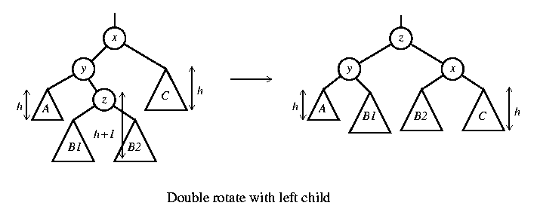
Double rotation
The new key is inserted in the subtree B1 or B2.
The AVL-property is violated at x.
x-y-z forms a zig-zag shape
also called left-right rotate

Slide 29
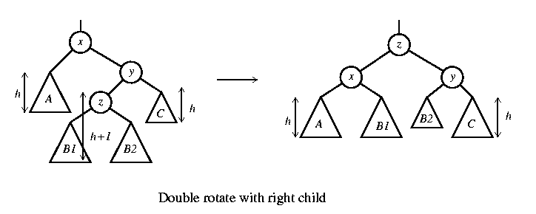
Continued…
The new key is inserted in the subtree B1 or B2.
The AVL-property is violated at x.
also called right-left rotate

Slide 30
Example: Double Rotations in AVL Tree
Double rotations: insert 1, 2, 3, 4, 5, 7, 6, 9, 8
First insert 1 and 2:
13
11
15
10
12
14
16

Slide 31
Continued…
Double rotations:
AVL violation - rotate
13
11
15
14
16
10
12
1
2

Slide 32
Continued…
Double rotations:
Rotation type:
13
11
15
14
16
10
12
1
2

Slide 33
Continued…
Double rotations:
AVL balance restored:
13
11
15
2
12
14
16
1
10
Now insert 3.

Slide 34
Continued…
Double rotations:
AVL violation – rotate:
13
11
15
2
12
14
16
1
10
3

Slide 35
Continued…
Double rotations:
Rotation type:
13
11
15
2
12
14
16
1
10
3

Slide 36
Continued…
Double rotations:
AVL balance restored:
13
10
15
2
11
14
16
1
3
12
Now insert 4.

Slide 37
AVL Tree Rotations
Double rotations:
AVL violation - rotate
13
10
15
2
11
14
16
1
3
12
4

Slide 38
Continued…
Double rotations:
Rotation type:
13
10
15
2
11
14
16
1
3
12
4

Slide 39
Continued…
Double rotations:
10
2
13
1
3
11
15
4
12
14
16
Now insert 5.

Slide 40
Continued…
Double rotations:
10
2
13
1
3
11
15
4
12
14
16
5
AVL violation – rotate.

Slide 41
Continued…
Single rotations:
Rotation type:
10
2
13
1
3
11
15
4
12
14
16
5

Slide 42
Continued…
Single rotations:
AVL balance restored:
10
2
13
1
4
11
15
3
5
12
14
16
Now insert 7.

Slide 43
Continued…
Single rotations:
AVL violation – rotate.
10
2
13
1
4
11
15
3
5
12
14
16
7

Slide 44
Continued…
Single rotations:
Rotation type:
10
2
13
1
4
11
15
3
5
12
14
16
7

Slide 45
Continued…
Double rotations:
AVL balance restored.
10
4
13
2
5
11
15
7
12
14
16
1
3
Now insert 6.

Slide 46
Continued…
Double rotations:
AVL violation - rotate.
10
4
13
2
5
11
15
7
12
14
16
1
3
6

Slide 47
Continued…
Double rotations:
Rotation type:
10
4
13
2
5
11
15
7
12
14
16
1
3
6

Slide 48
Continued…
Double rotations:
AVL balance restored.
10
4
13
2
6
11
15
12
14
16
1
3
5
7
Now insert 9 and 8.

Slide 49
Continued…
Double rotations:
AVL violation - rotate.
10
4
13
2
6
11
15
12
14
16
1
3
5
7
9
8

Slide 50
Continued…
Double rotations:
Rotation type:
10
4
13
2
6
11
15
12
14
16
1
3
5
7
9
8

Slide 51
Continued…
Final tree:
Tree is almost perfectly balanced
10
4
13
2
6
11
15
12
14
16
1
3
5
8
7
9

Slide 52
Deletion
Delete a node x as in ordinary binary search tree. Note that the last node deleted is a leaf.
Then trace the path from the new leaf towards the root.
For each node x encountered, check if heights of left(x) and right(x) differ by at most 1. If yes, proceed to parent(x). If not, perform an appropriate rotation at x. There are 4 cases as in the case of insertion.
For deletion, after we perform a rotation at x, we may have to perform a rotation at some ancestor of x. Thus, we must continue to trace the path until we reach the root.

Slide 53
Deletion
On closer examination: the single rotations for deletion can be divided into 4 cases (instead of 2 cases)
  Two cases for rotate with left child
  Two cases for rotate with right child

Slide 54
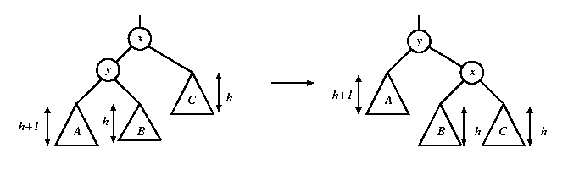
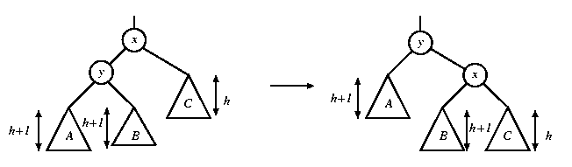
Single rotations in deletion
In both figures, a node is deleted in subtree C, causing the height to drop to h. The height of y is h+2. When the height of subtree A is h+1, the height of B can be h or h+1. Fortunately, the same single rotation can correct both cases.
rotate with left child

Slide 55
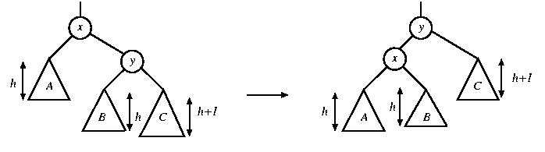
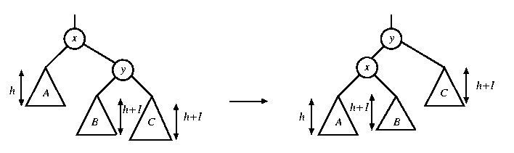
Single rotations in deletion
In both figures, a node is deleted in subtree A, causing the height to drop to h. The height of y is h+2. When the height of subtree C is h+1, the height of B can be h or h+1. A single rotation can correct both cases.
rotate with right child

Slide 56
Rotations in deletion
There are 4 cases for single rotations, but we do not need to distinguish among them.
There are exactly two cases for double rotations (as in the case of insertion)
Therefore, we can reuse exactly the same procedure for insertion to determine which rotation to perform

